Slide 1
Secure & Scalable AWS VPC Architecture for Small-to-Medium Businesses
Mohammed Aziz Alyami 442170174

Slide 2
Project Overview
Objective:
Build a secure, fault-tolerant cloud network for a business using AWS VPC, Auto Scaling, and Load Balancing.
Key Components:
Public/Private Subnets in 2 AZs.
NAT Gateway, Internet Gateway, Security Groups.
Application Load Balancer (ALB) & Auto Scaling Group (ASG).
Why It Matters:
Ensures business continuity, scalability, and protection against outages.

Slide 3
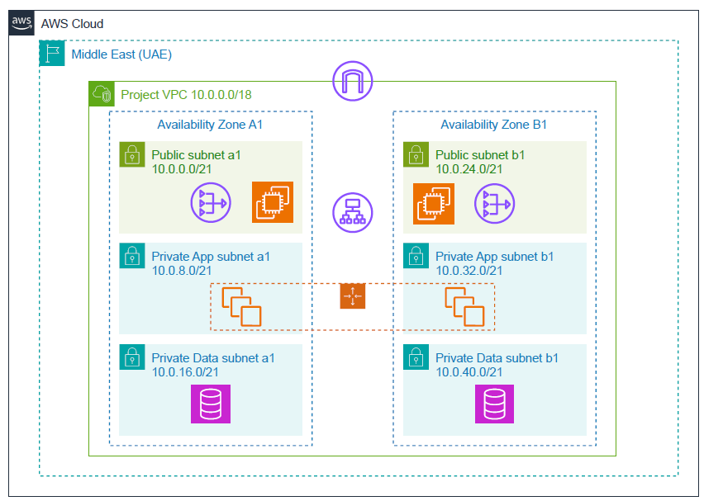
Architecture Diagram
Multi-AZ redundancy for high availability.
Traffic flows through the ALB to auto-scaled instances.

Slide 4
Subnet Design
UNIQUEVVPC CIDR: 10.0.0.0/18 (IP Range: 10.0.0.0–10.0.63.255).PC CIDR: 10.0.0.0/18 (IP Range: 10.0.0.0–10.0.63.255).
Subnet Type | AZ | CIDR Block | Purpose
Public-Subnet-1a | me-central-1a | 10.0.0.0/21 | NAT Gateway, Bastion Host
Private-App-1a | me-central-1b | 10.0.8.0/21 | Auto-Scaled EC2 Instances
Private-Data-1a | me-central-1a | 10.0.16.0/21 | Databases
Public-Subnet-1b | me-central-1b | 10.0.24.0/21 | NAT Gateway, Bastion Host
Private-App-1b | me-central-1b | 10.0.32.0/21 | Auto-Scaled EC2 Instances
Private-Data-1b | me-central-1b | 10.0.40.0/21 | Database
Subnets are sized to avoid IP exhaustion while maintaining isolation.

Slide 5
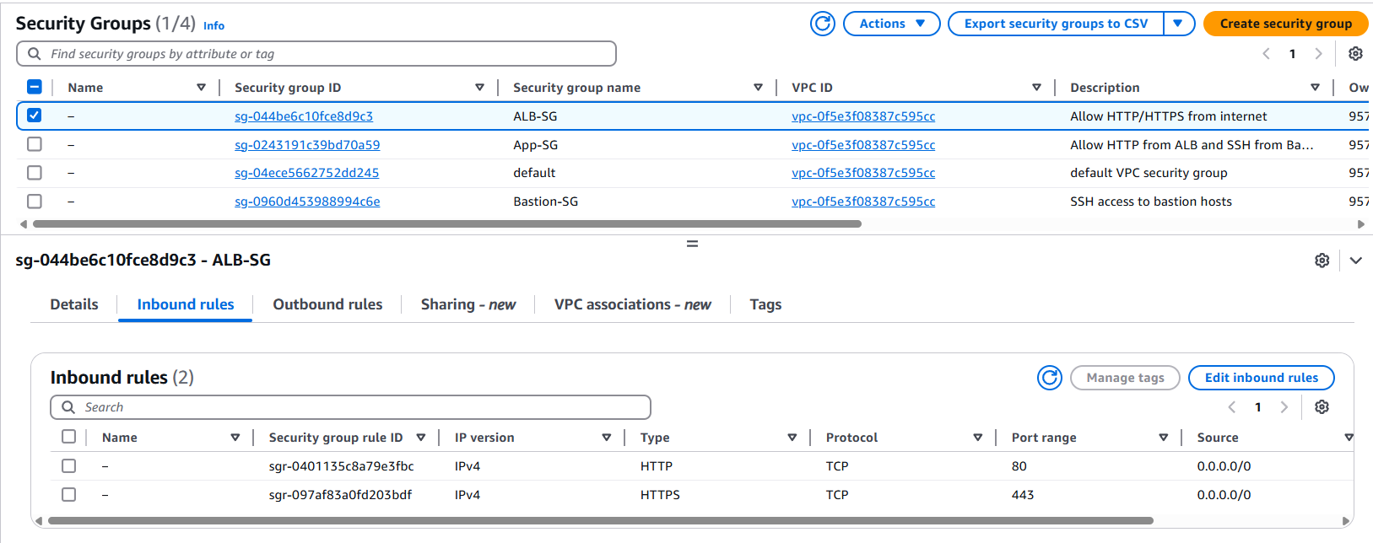
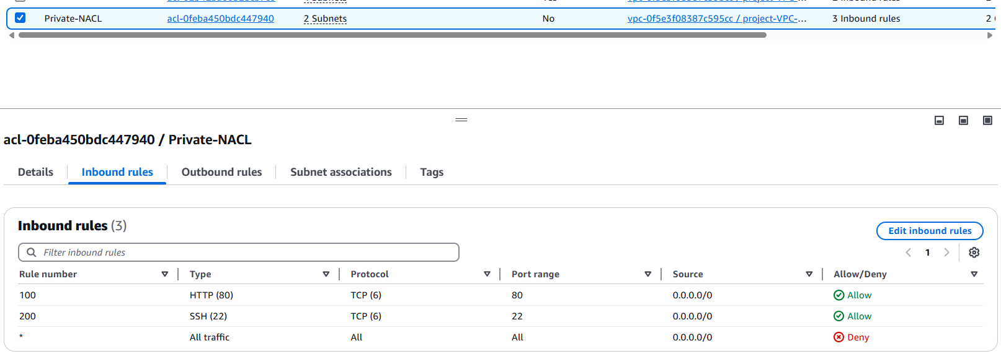
Security & Compliance
Security Groups:
Bastion-SG: Allow SSH only from trusted IPs.
App-SG: Allow HTTP from ALB-SG and SSH from Bastion-SG.
ALB-SG: Allow HTTP/HTTPS from the internet.
Network ACLs:
Block all inbound traffic except HTTP/SSH from trusted subnets.
Best Practices:
Least privilege access prevents unauthorized traffic.

Slide 6
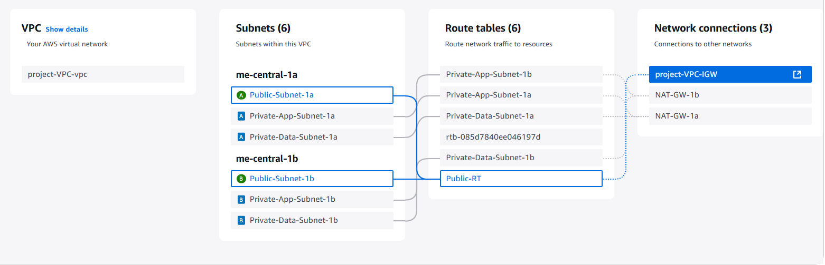
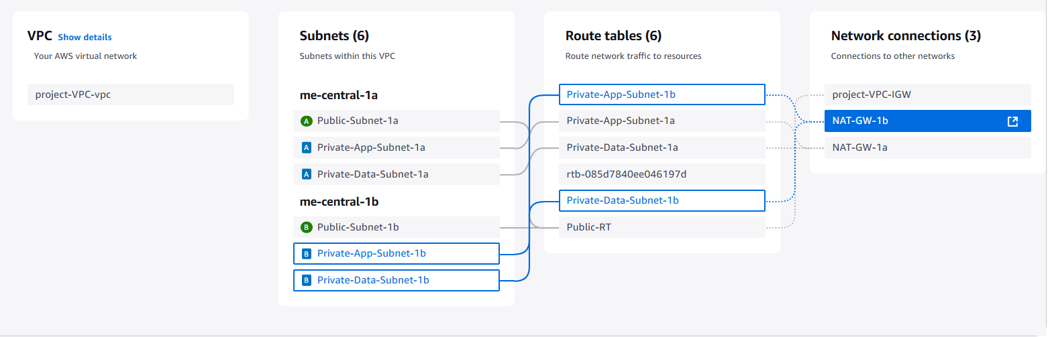
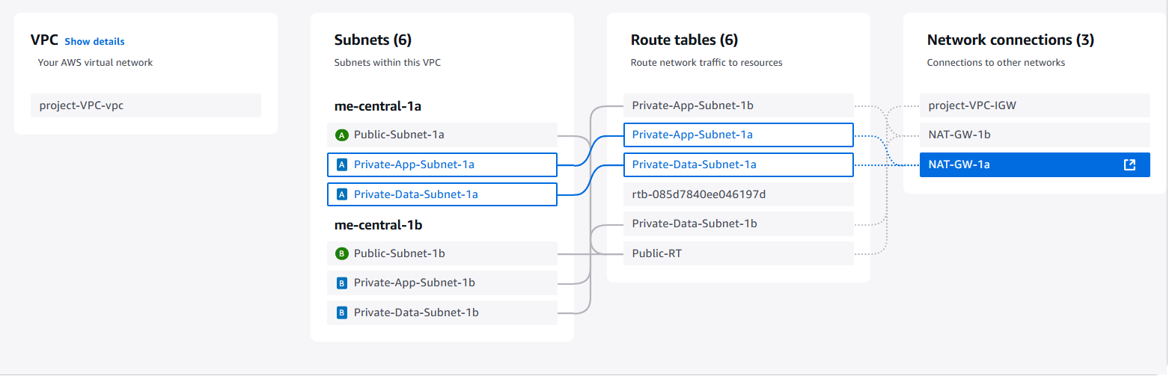
Connectivity & Routing
Internet Gateway (IGW):
Attached to the VPC for public subnet internet access.
NAT Gateways:
Private subnets use NAT Gateways in their AZ for outbound traffic.
Route Tables:
Public Route Table: 0.0.0.0/0 → IGW.
Private Route Tables: 0.0.0.0/0 → NAT Gateway (per AZ).

Slide 7
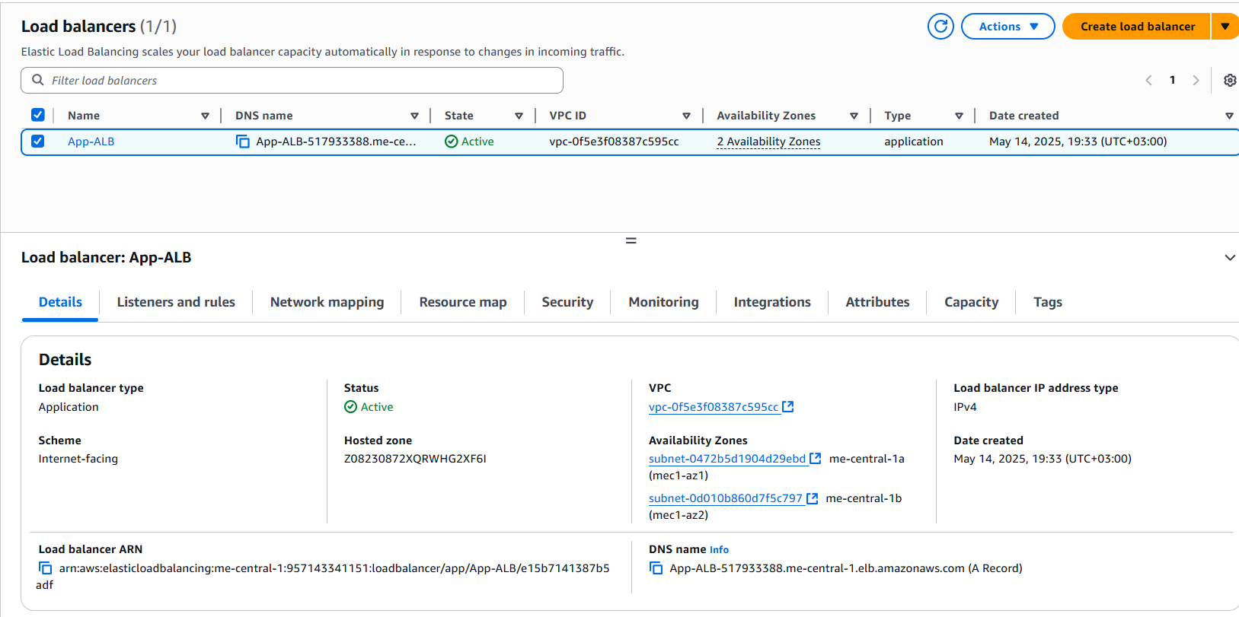
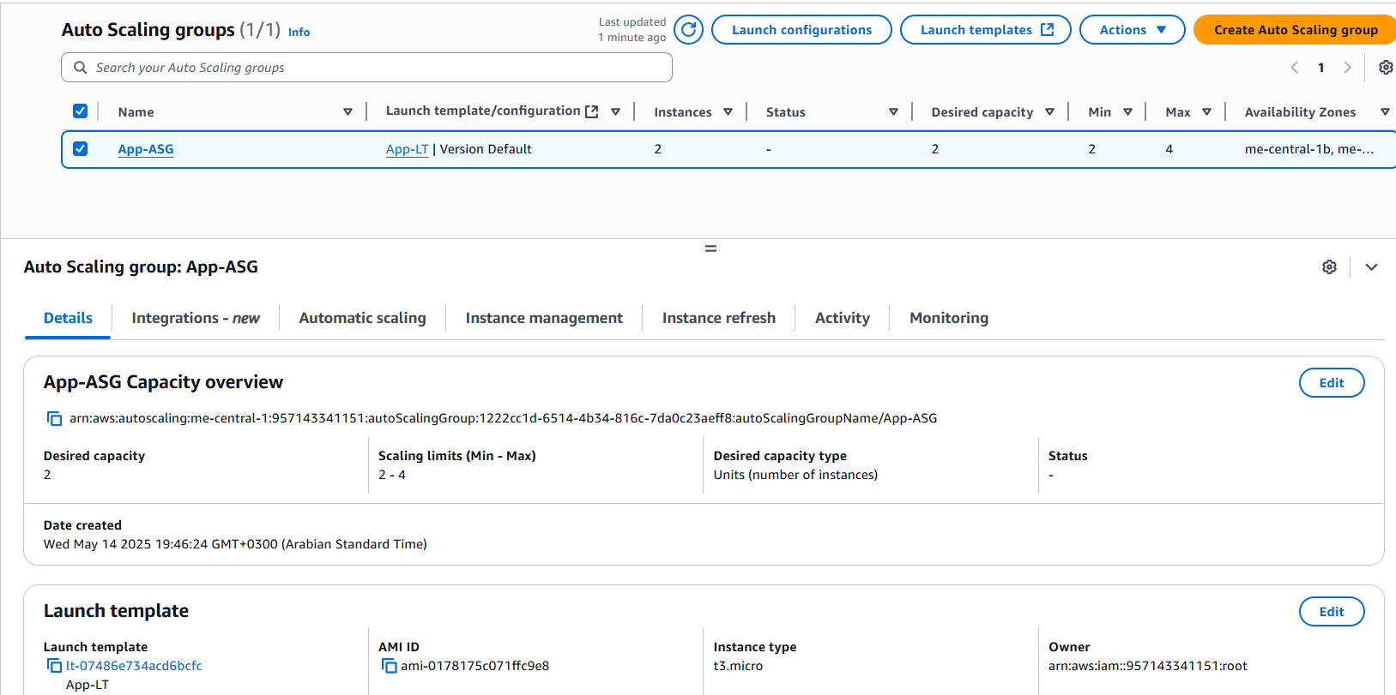
Scalability & High Availability
Application Load Balancer (ALB):
Distributes traffic across instances in multiple AZs.
Health checks ensure only healthy instances receive traffic.
Auto Scaling Group (ASG):
Maintains 2–4 EC2 instances based on CPU usage.
Launch template uses Amazon Linux 2023 with Apache.

Slide 8
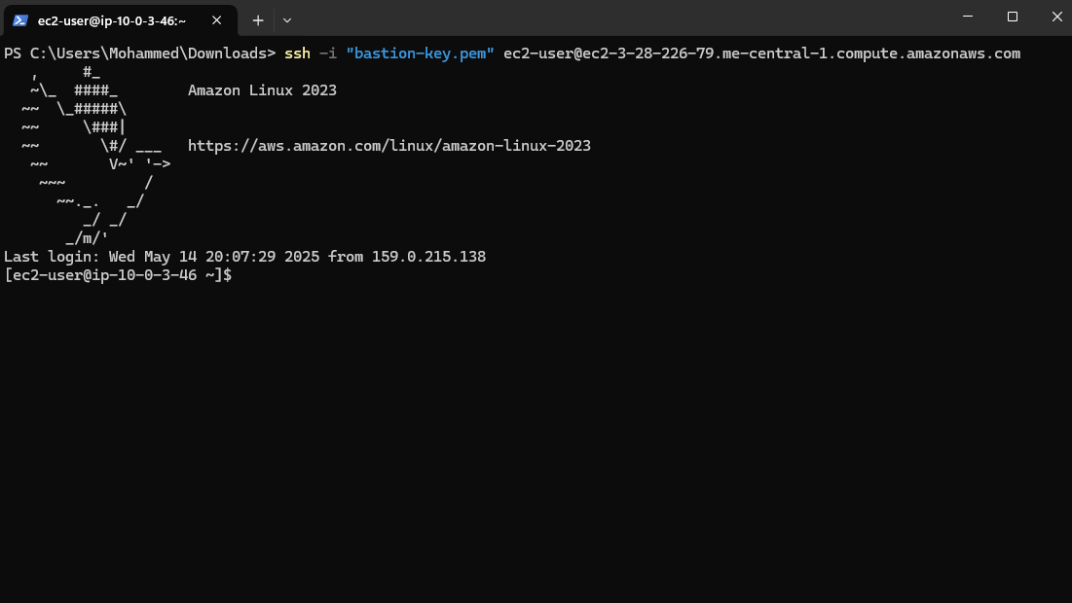
Testing & Validation
Tests Conducted:
ALB Access: Accessed ALB DNS name → Confirmed HTTP 200 response.
SSH via Bastion: Connected to private instances using bastion hosts.
Auto Scaling Test: Terminated an instance → Verified replacement.

Slide 9
Challenges, Learnings
Challenges
Learnings
Configuring route tables for multi-AZ traffic was initially confusing.
Debugging security group rules took time.
Tagging resources early avoids confusion.
Infrastructure-as-Code (e.g., Terraform) saves time for future projects.

